Slide 1
Community Analysis of Next Venues in Seattle, WA
Nicole L Thompson

Slide 2
Motivation
How to determine joint promotions for businesses?
How to determine which venues to include in events (pub crawls, events across parks, etc)?

Slide 3
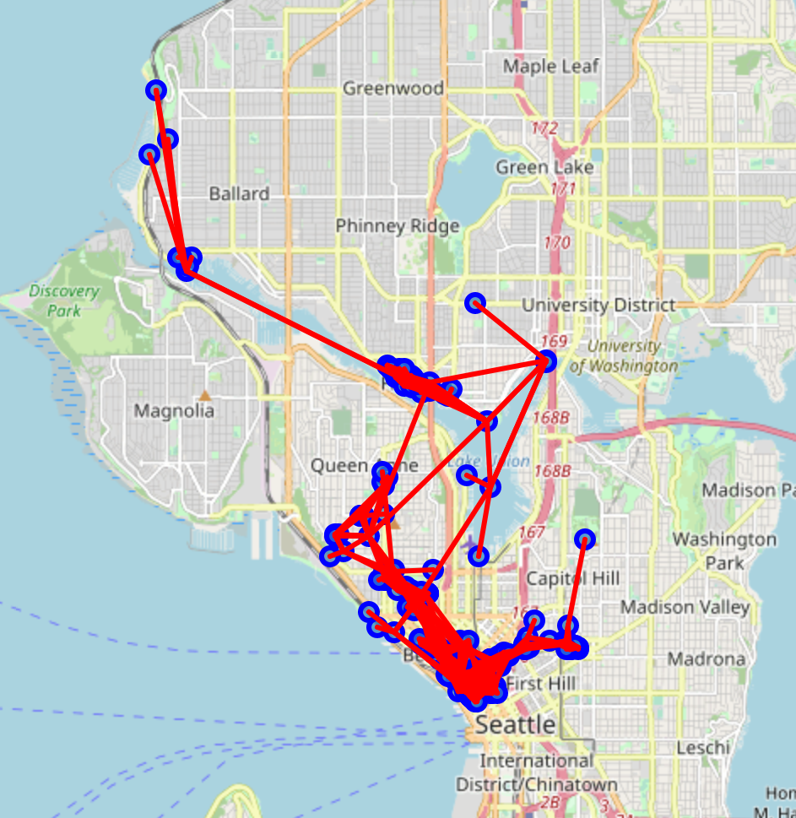
Foursquare Next Venues Data
Provides list of venues people tend to check into following current venue
Allows for construction of next venues representing how people move between venues
Data collected was centered around Seattle
blue points are venues
red lines are “next venue” connections

Slide 4
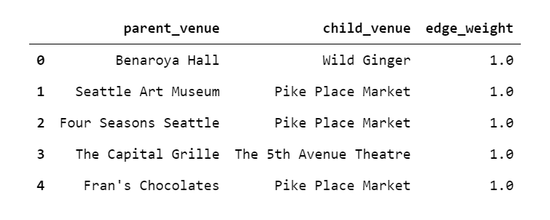
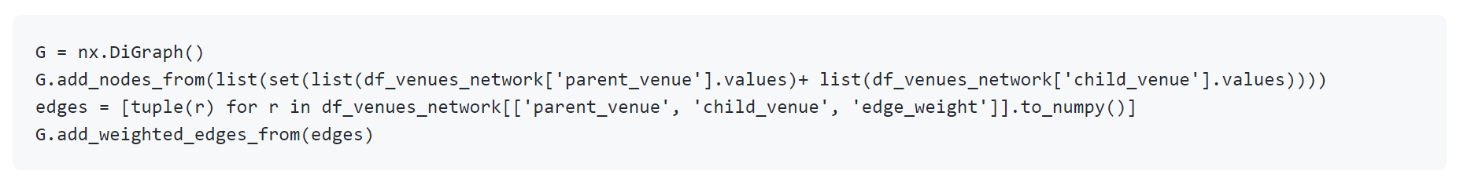
Venues Network
Nodes are venues
Edges are weighted by order they appear on “next venues” list retrieved from Foursquare
1.0 for first, 0.8 for second, 0.6 for third, 0.4 for fourth, 0.2 for fifth (last)
networkx library directed graph

Slide 5
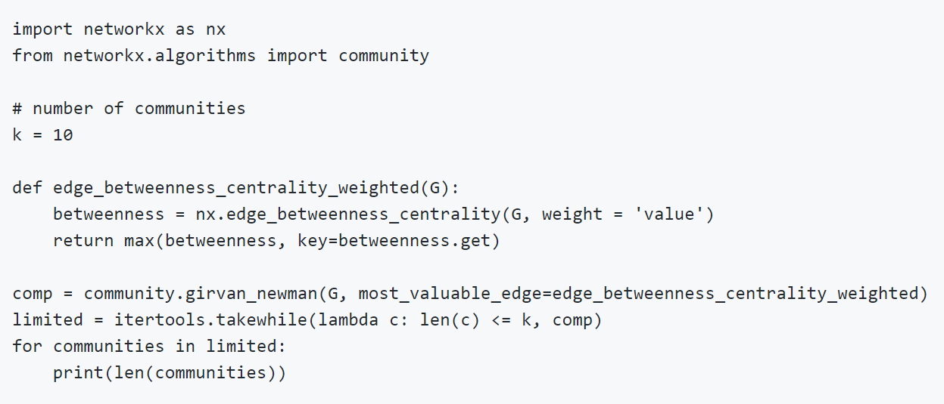
Community Detection
Girvan-Newman algorithm was used until 10 communities were discovered
Divisive algorithm (removes edges iteratively)
Most valuable edge was determined by weighted edge betweenness centrality

Slide 6
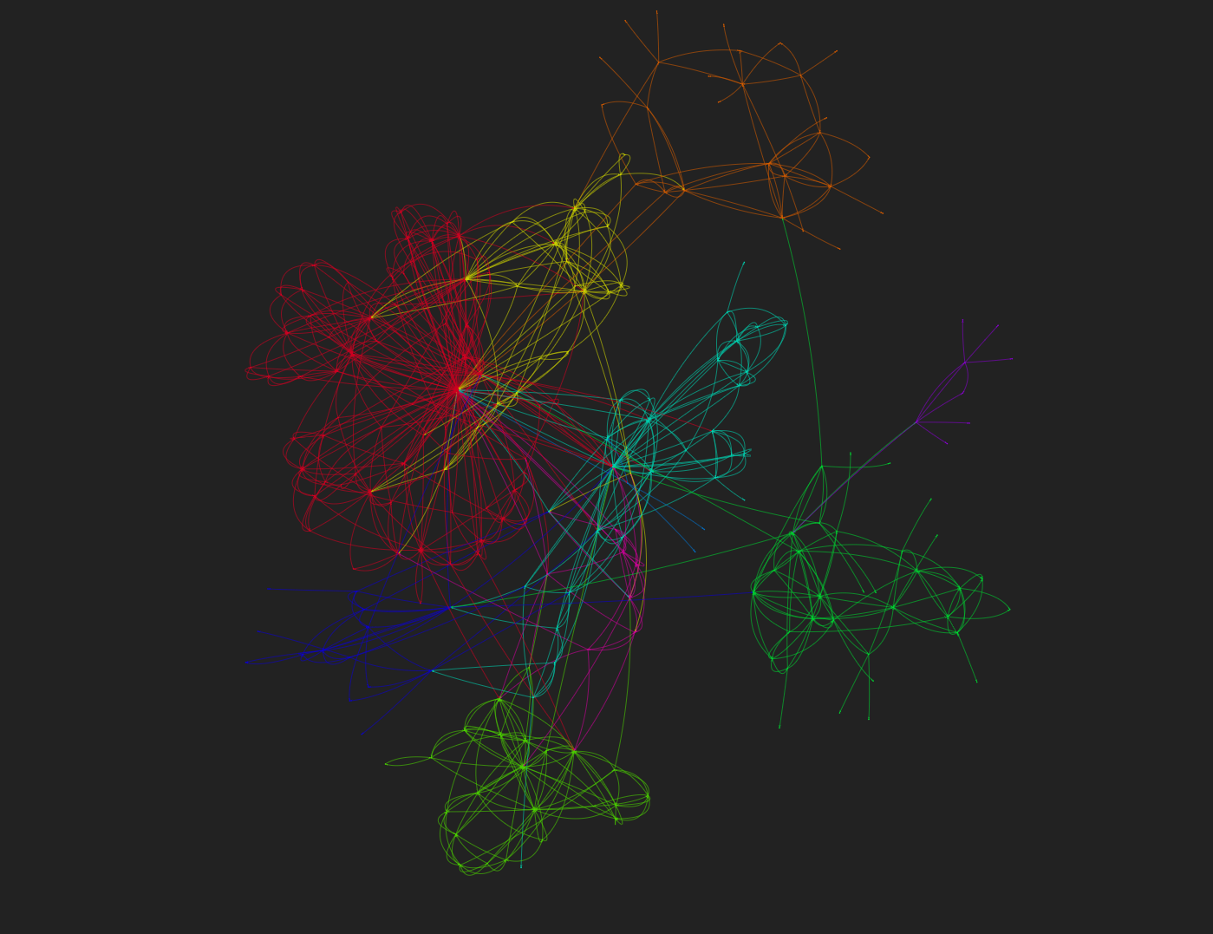
Results: Community Detection Pyvis Network
The interactive html version of this network can be found on github: https://github.com/nicolet5/network-analysis-of-seattle-venues/blob/main/docs/images/next_venues_communities_network.html

Slide 7
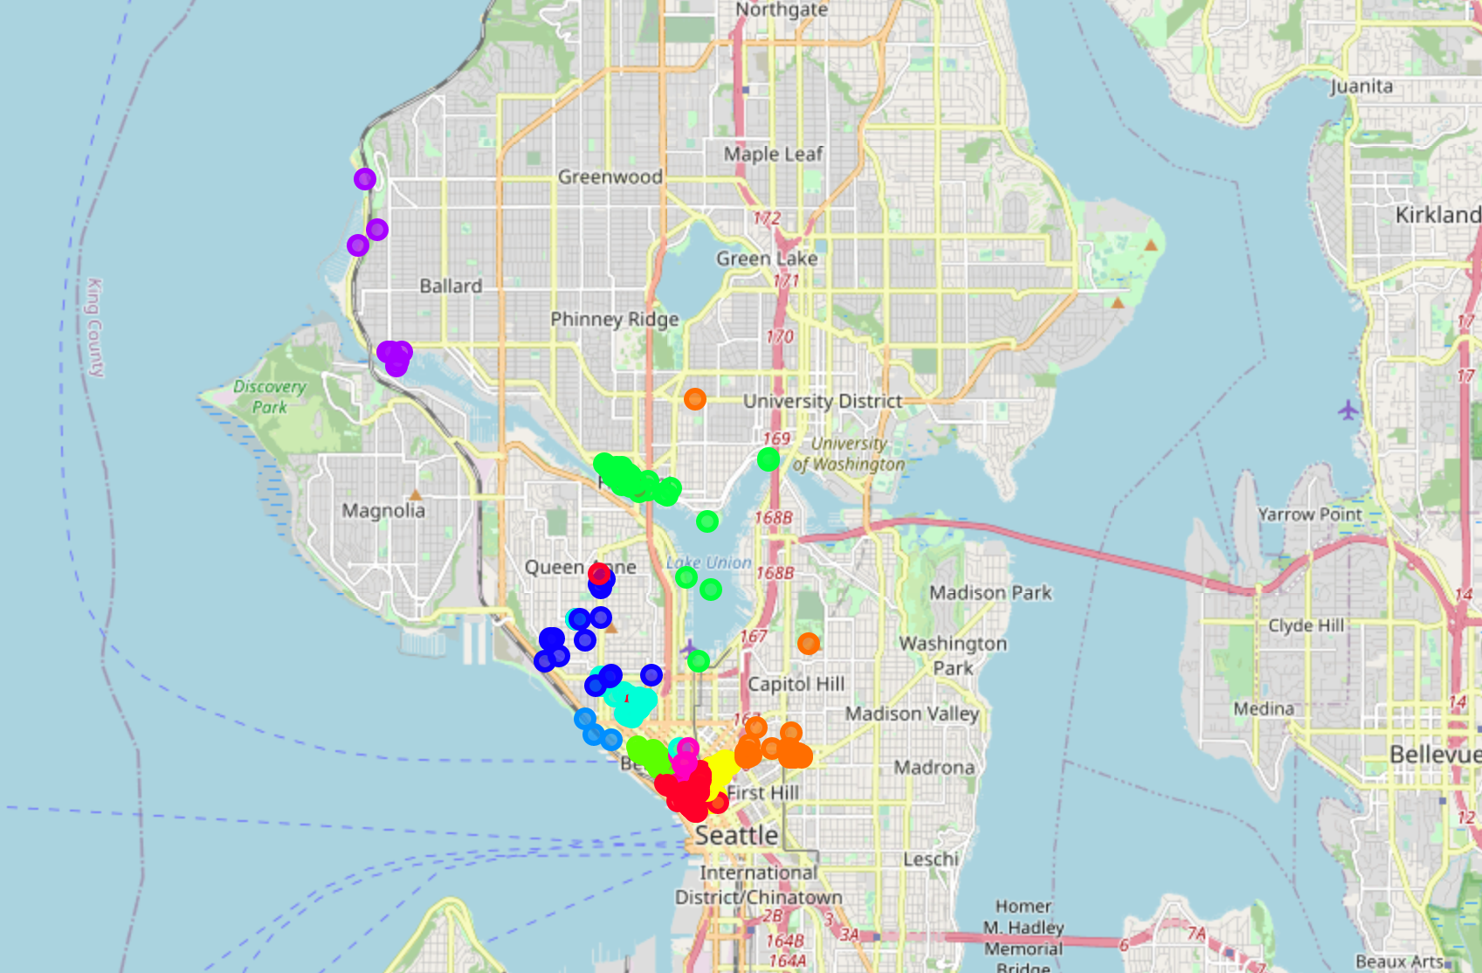
Results: Community Detection Map
The interactive html version of this network can be found on github: https://github.com/nicolet5/network-analysis-of-seattle-venues/blob/main/docs/images/folium_seattle_map_communities.html

Slide 8
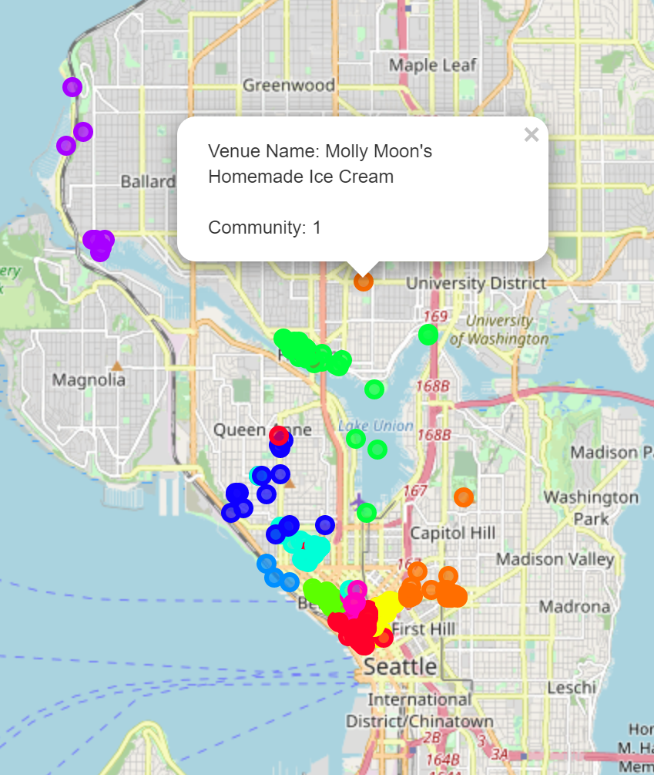
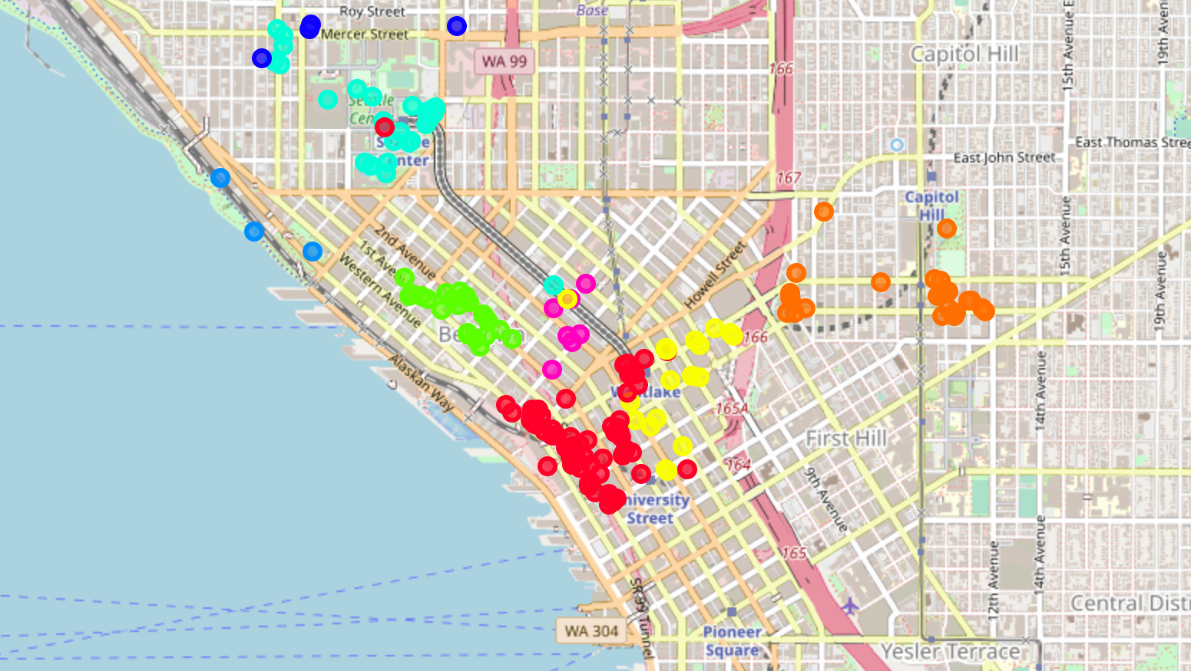
Communities are not always geographical

Slide 9
Communities Analysis
Communities are largely determined by geographical closeness (but not always)
Varying communities have varying geographical sparseness across Seattle
Examined further with average distance between each node within the community (shown on next slide)
Categories of venues within each community vary
Nightlife, shops and services, food, etc.

Slide 10
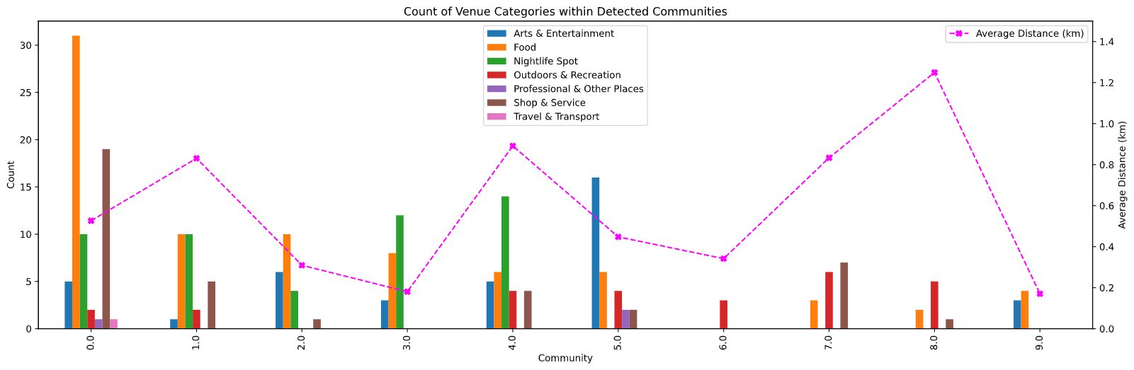
Characterizing Communities

Slide 11
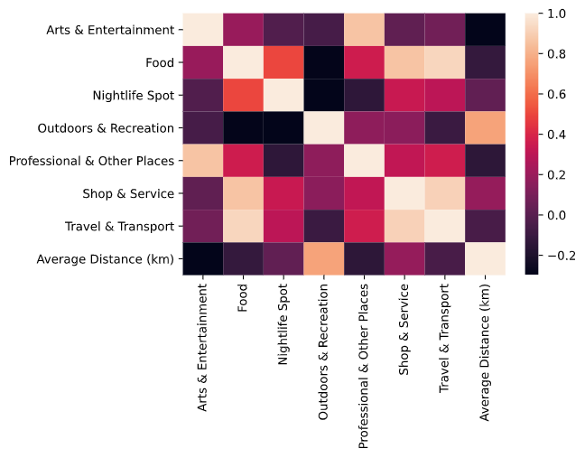
Characterizing Communities
Average distance between nodes is highly correlated with “Outdoors and Recreation”
Communities with a higher number of these types of venues (e.g. parks) are geographically more spread out

Slide 12
Conclusions
Community detection shows business owners may need to look further than their geographical community for joint promotions
Querying this network for which community a business belongs to provides which other venues may be good joint promotion targets
Varying communities have varying sparseness
Communities with higher portions of outdoor and recreation sites are more spread out

